Slide 1
GBT Project Report
Block-based Parallel Tree Building in GBT
Bo Peng
IPCC@Indiana University

Slide 2
Outline
The problem and basic ideas
Current results
Plan for next step

Slide 3
The Problem
Goal: Build a high performance GBT trainer
Solution:
Block-based Model Parallelism(DAAL Tree Building Kernel)
+ Model Rotation(Harp CollectiveCommunication)
+ Sampling(optional)
Problem:
How to optimize parallel tree building in GBT?
How to do model parallelism in GBT, and why?
How to do sampling effectively in GBT?

Slide 4
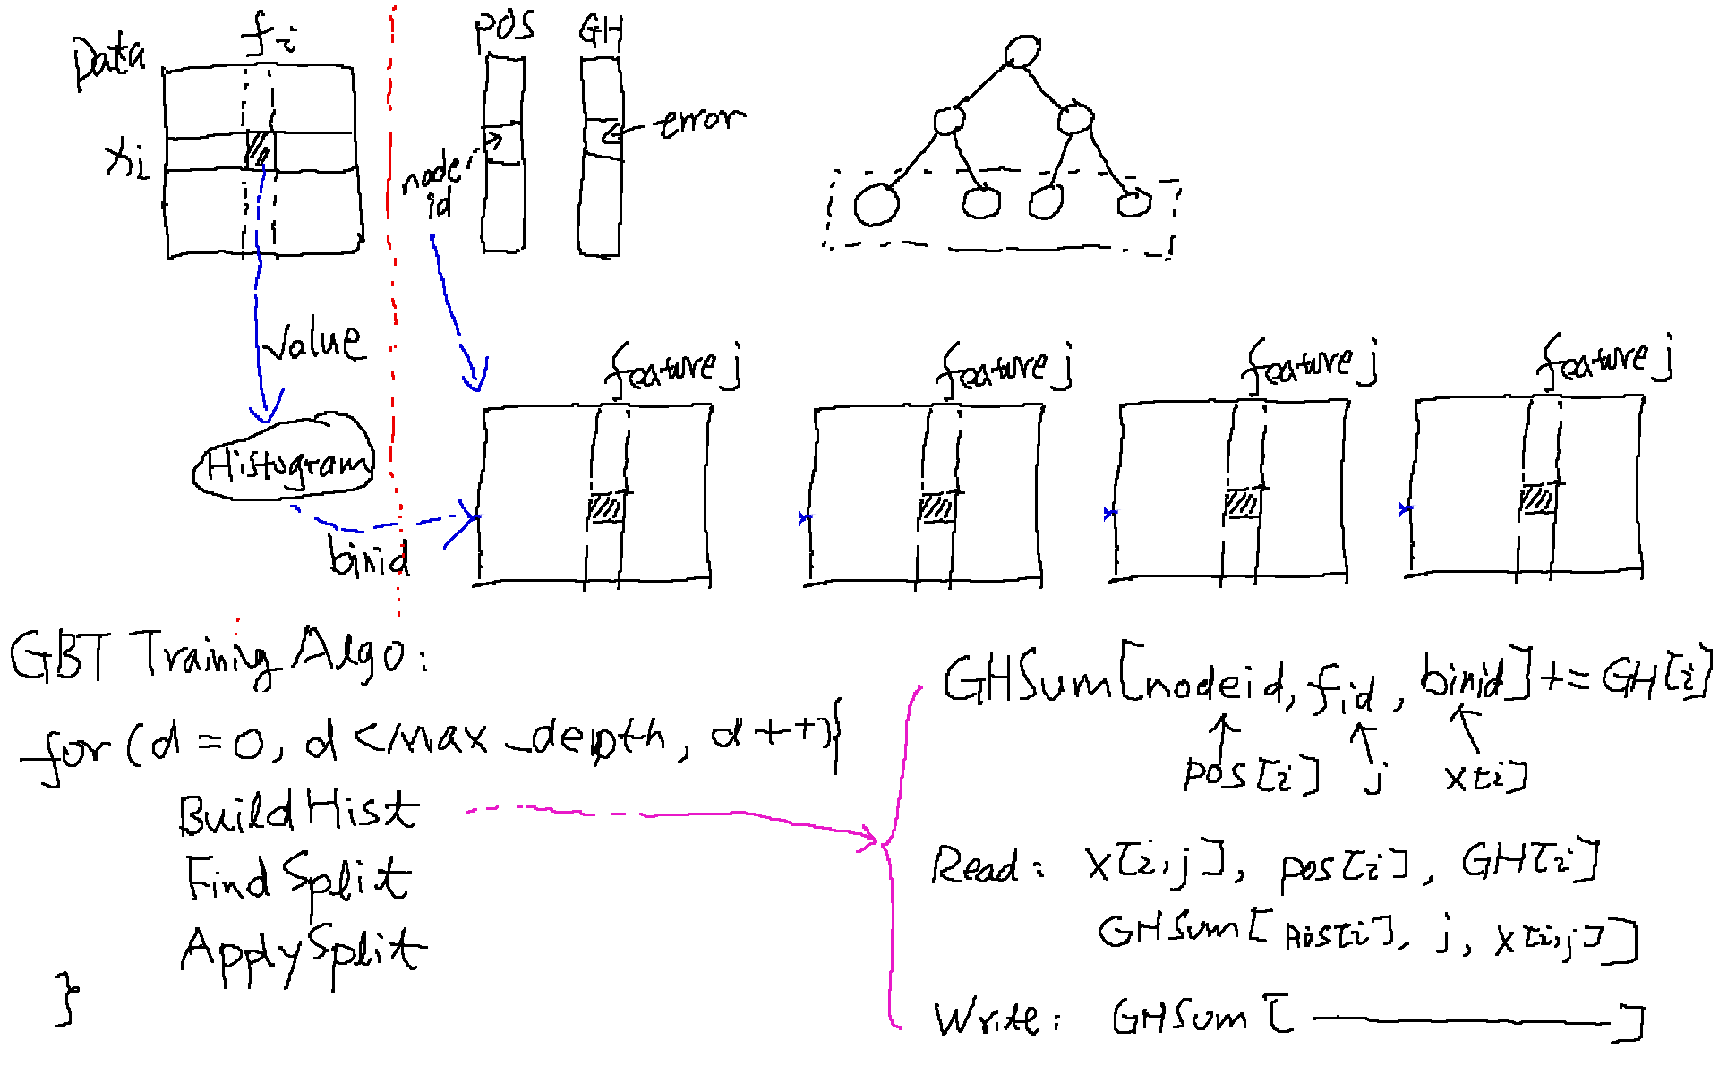
GBT Recap

Slide 5
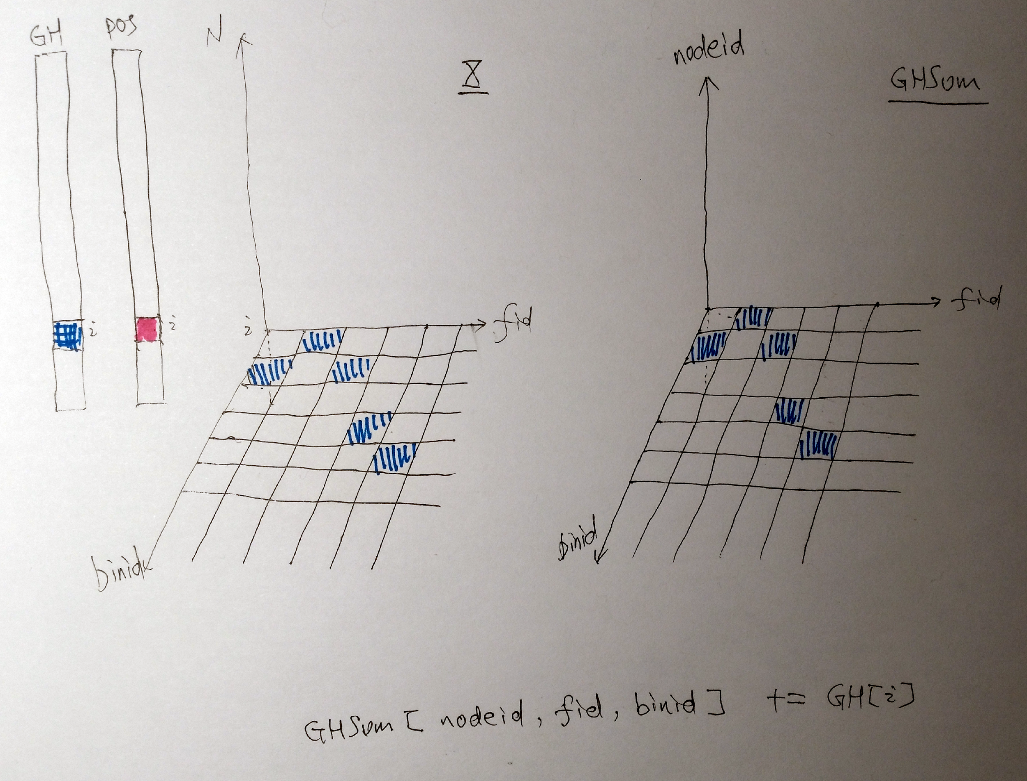
BuildHist

Slide 6
Proposed Solution: Block-based Parallelism
a general or mixture solution:
model parallelism:
GHSum is a 3-D matrix <nodeid, featureid, binid> three levels of parallelism
small BLOCKS(cubes) in GHSum is the basic unit for parallelism
Threads write to the local BLOCK without conflicts
no thread local replicas, therefore, no thread synchronizations(not many)
able to release memory as soon as subset of BLOCKS are done (release after FindSplit)
suitable for
many cores
numa
distributed version

Slide 7
Proposed Solution: Block-based Parallelism
nodeid:
node_block_size=0, -> one block, one thread works on all the nodeids -> sequential access: read blocks of training data sequentially, access POS/GH sequentially , read cache friendly
node_block_size=1, → num_leaves of blocks ->random access to training data and POS/GH, write cache friendly to one plain < featureid, binid>
featureid:
feature_block_size=0, -> all features in one block, one read of POS/GH can be reused to write to all these features’ cells , (less number of parallelism)
feature_block_size=1, -> redundant read of POS/GH by different threads
binid:
binid_block_size=0, -> normal setting,
binid_block_size=1, -> add 256 level of parallelism at the cost of accesing to a sparse input

Slide 8
Proposed Solution: Block-based Parallelism
block in training data is defined as <row_blk_size, bin_blk_size, feature_blk_size>
no random read access to training data and GH/POS
select the size parameters to control the read redundancy of GH/POS and cache performance
thread write to region in GHSum <Bin_blk_size, Node_size, Feature_blk_size>
different memory layout, BNF by default
select the size parameters to control the write cache performance

Slide 9
Block-based Parallelism Implementation
Definition of BLOCK:
Training Data organized as blocks correspondingly
BlockCfg := <row_blk_size, node_blk_size, bin_blk_size, feature_blk_size>, 0 for all
Block-based parallelism
block=<0, 1,0,1> equals to feature-wised solution xgb-approx and daalgbt-2018
block=<X, 1,0,0> similar to row-wised solution xgb-hist(without model replicas), with limited parallelism at the first few levels
block=<X, 1,16,0> similar to the above one, supporting 16 threads write to model without conflicts in the beginning
block=<0, 0, 0,16> keep balance for read/write
block=<X,0,0,1> harpdaal-block mainly tested in the following slides
...

Slide 10
Evalutation

Slide 11
Configuration
machine
CPU: Intel(R) Xeon(R) CPU E5-2699 v3 @ 2.30GHz
Cores: 2 Sockets x36 cores each = 72 Cores (thread# set to 32)
RAM: 128 GB
Compiler
gcc (crosstool-NG fa8859cb) 7.2.0
icc (ICC) 19.0.0.117 20180804
Software
xgboost, Latest commit 6a569b8,
lightgbm, Latest commit 7282533
dallgbt, 2019-update1.1

Slide 12
Dataset
dataset | train# | test# | features# | sparsity | size
synset | 1m |  | 1024 | dense | 22 GB
airline | 1m | 100K | 690 | dense(one-hot encoding) | 2.6 GB/63 MB
higgs | 10m | 1m | 28 | dense | 4.8 GB

Slide 13
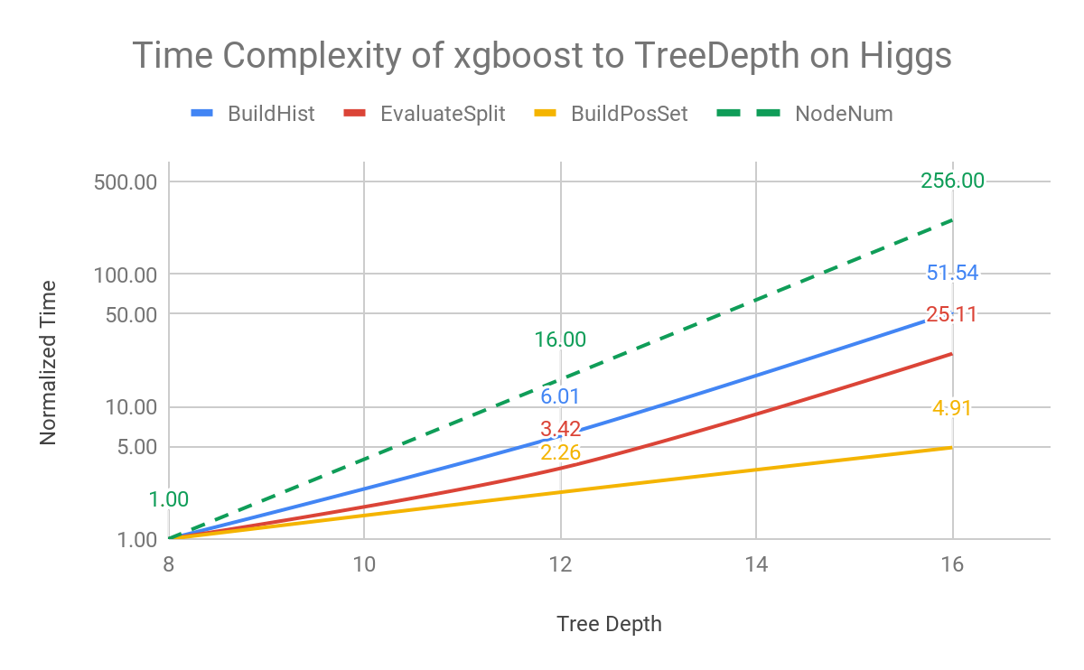
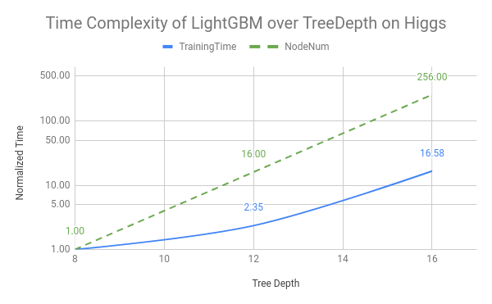
Bottleneck Analysis on xgb-hist
run trainers on higgs with tree_depth=8,12,16, (thread=32)
critical part: BuildHist, BuildPosSet, EvaluateSplit

Slide 14
Bottleneck Analysis on xgb-hist
BuildHist(BuildHist+BuildPosSet) occupy ~95%, EvaluateSplit occupy ~2%~5% of the training time.
BuildHist is the major bottleneck, and has Expoential growth over the tree depth.
why?
In BuildHist, the number of memory R/W is proportional to the number of tree depth. The execution time should ideally keep linear over tree depth.
xgb-hist: number of thread synchronization proportional to the node numbers, in order to control the memory footprint of thread-local model copies

Slide 15
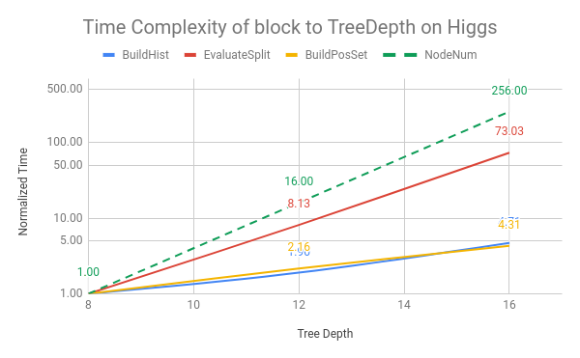
Bottleneck Analysis on harpdaal-block
Higgs, eta=0.1, num_round=10, thread=32, block=<500k,0,0,1>
Expoential growth to the tree depth.
much better the coefficient of the growth
EvaluateSplit actually is a very small number
size of the GHSum is proportional to the node numbers, therefore, cache miss rate increases when the node_block_size set to 0, which introduce exponential growth of time
set node_block_size to smaller number may help in deep tree.(todo)

Slide 16
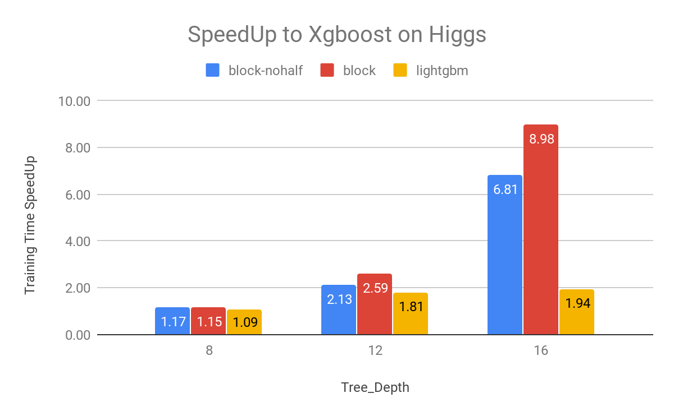
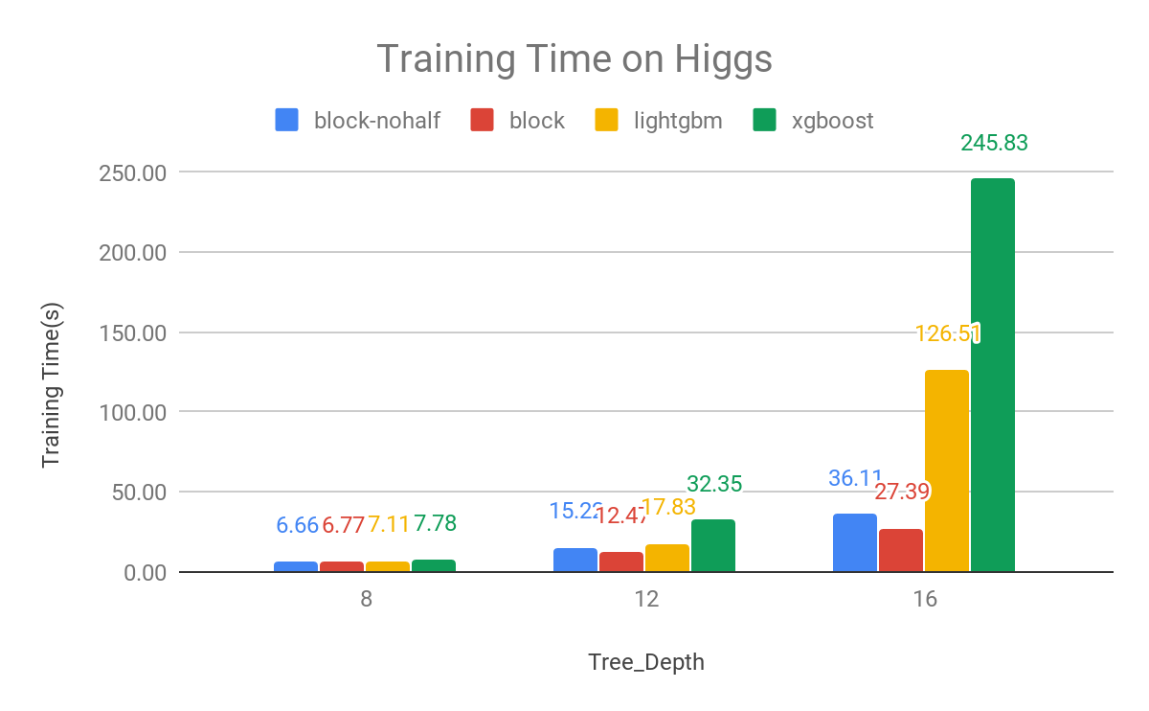
Higgs
Higgs, eta=0.1, num_round=10, thread=32, block=<500k,0,0,1>
Speedup to xgboost-hist of Training Time

Slide 17
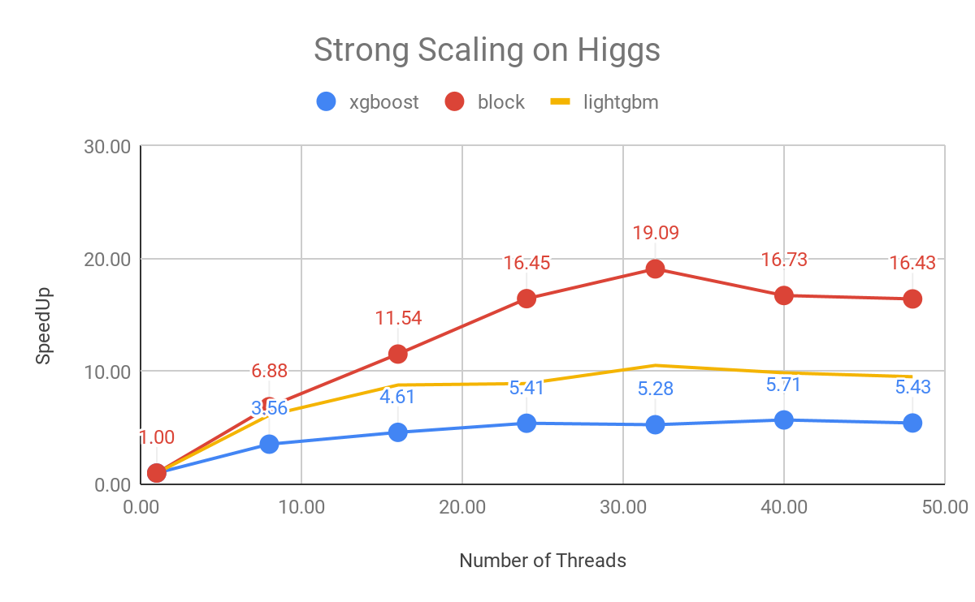
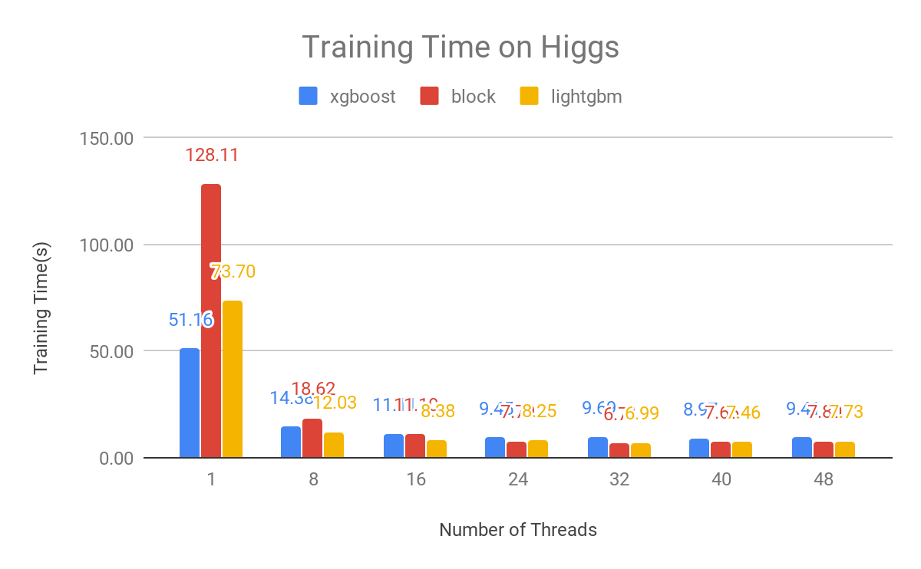
Higgs, eta=0.1, num_round=10, thread=32, block=<0.05,0,0,1>
Strong Scaling of Multithreading

Slide 18
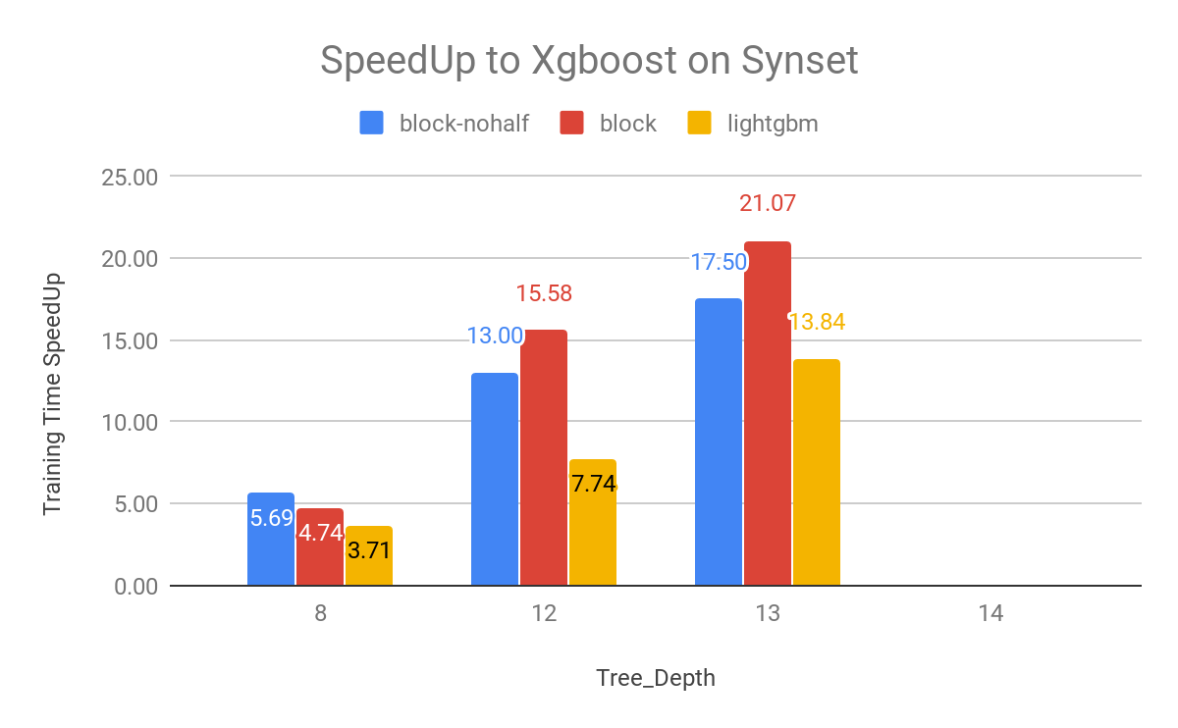
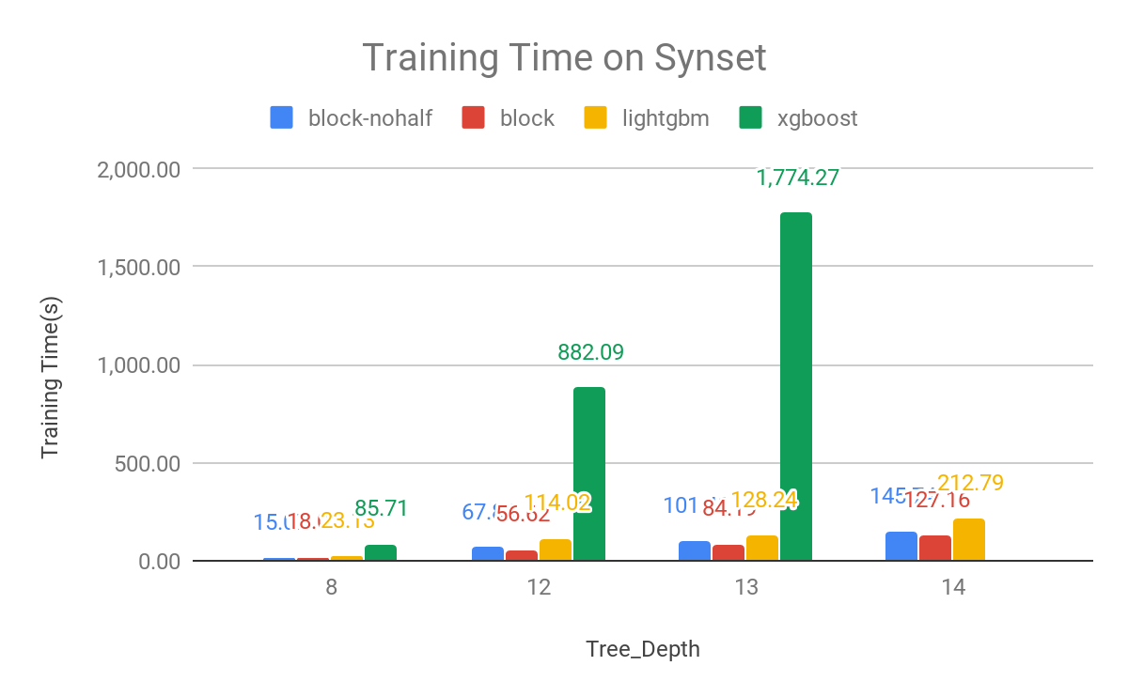
Synset
Synset, eta=0.1, num_round=10, thread=32, block=<500k,0,0,1>
xgboost runs out-of-memory for tree_depth=14 (GHSum size=64GB)

Slide 19
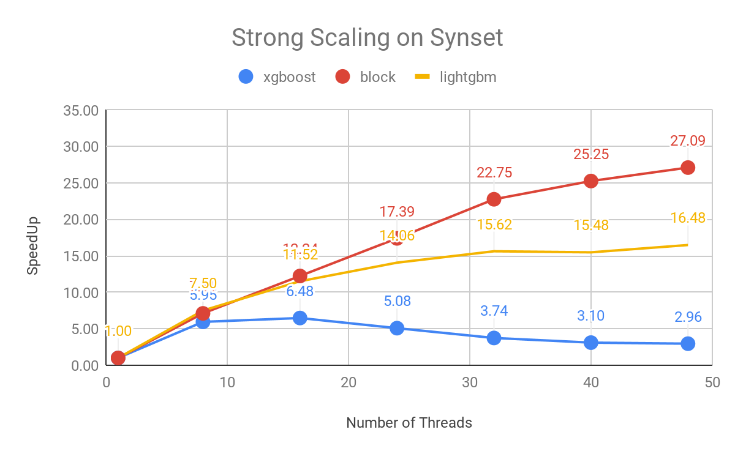
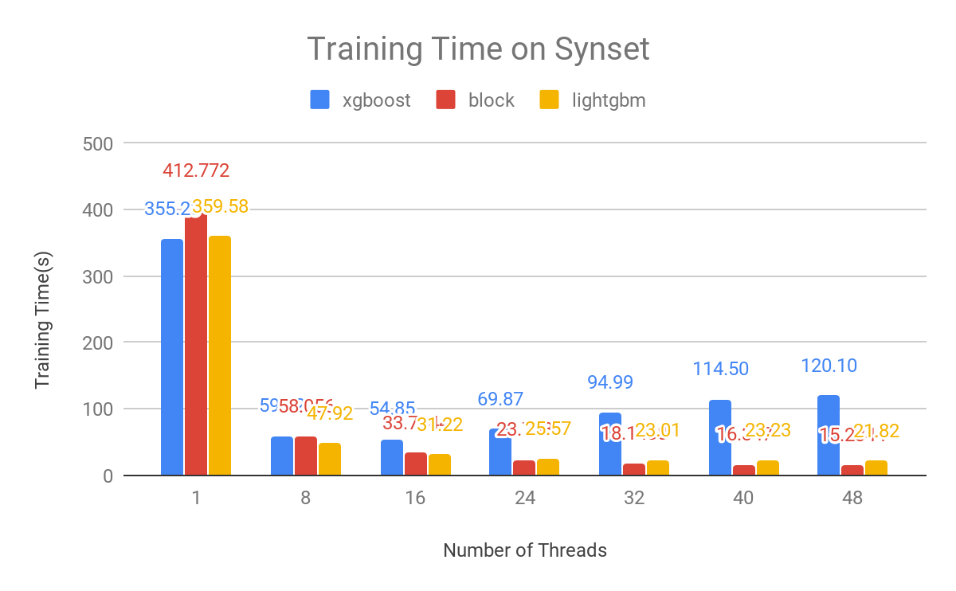
Synset, eta=0.1, num_round=10, thread=32, block=<500k,0,0,1>
Strong Scaling of Multithreading

Slide 20
Exploration
slides underbeath are not ready yet.

Slide 21
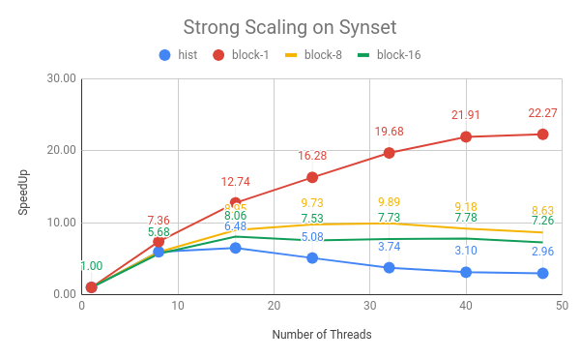
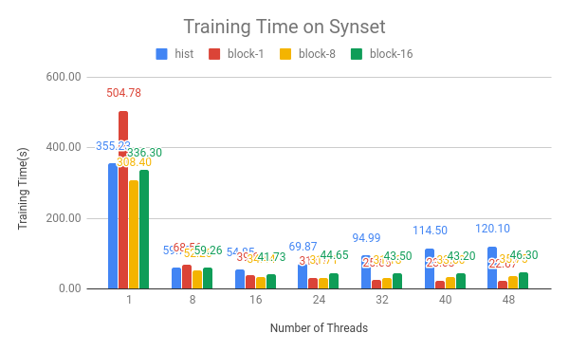
What’s the influences of block size?
Synset, tree_depth=8, num_round=10, block=<100k,0,0,X>
block-X:X=1, 8, 16

Slide 22
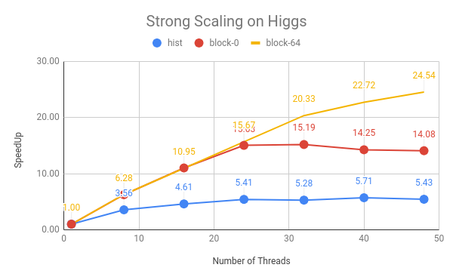
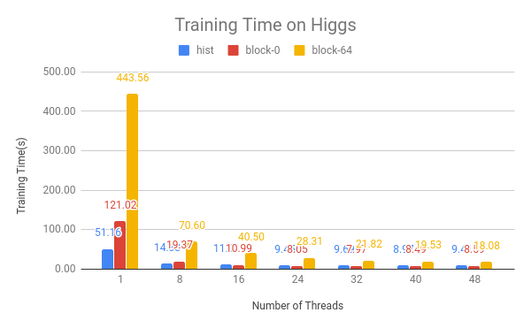
Is BINID level parallelism useful?
higgs, only 28 features, hard to scale above 28 threads
block-0, block=<500k,0,0,1>
block-64, block=<500k,0,64,1>
it does help for scale up
currently simple CSR format, need more compact data orgnization

Slide 23
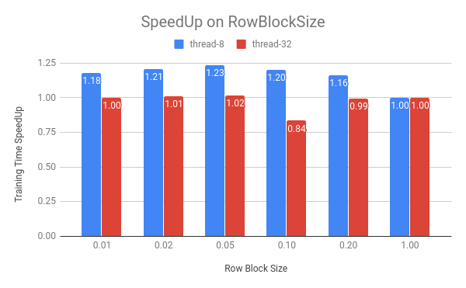
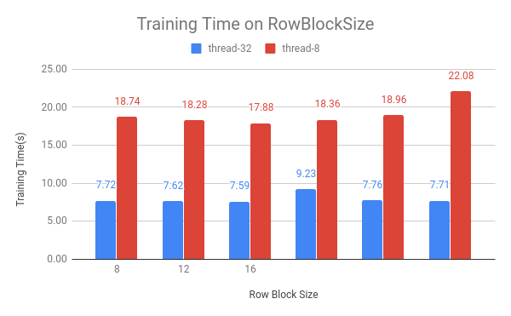
Is RowBlock useful?
higgs, 10M training instances, POS/GH total=20*10M=200MB
does not fit into LLC
read sequentially, but independently by all the threads
reduntant load when thread number < feature number

Slide 24
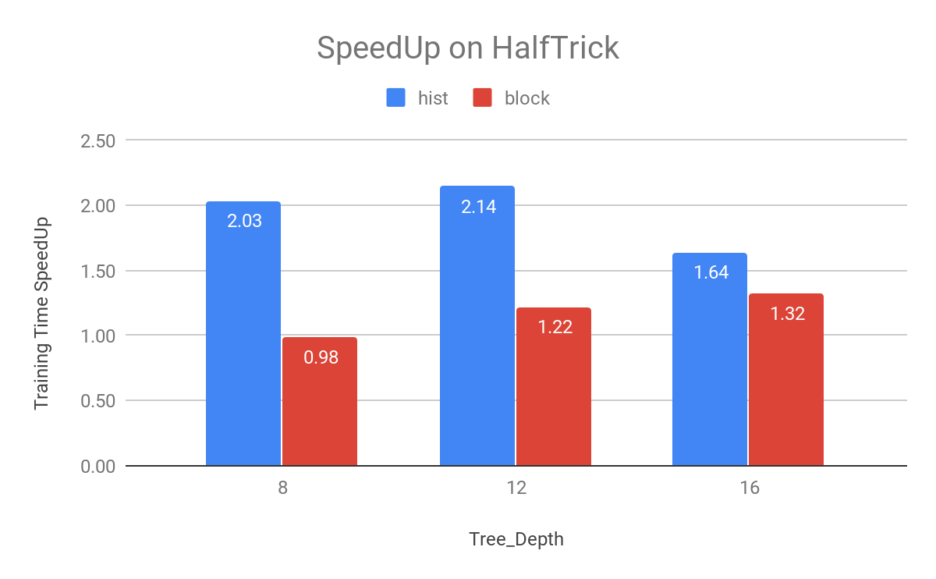
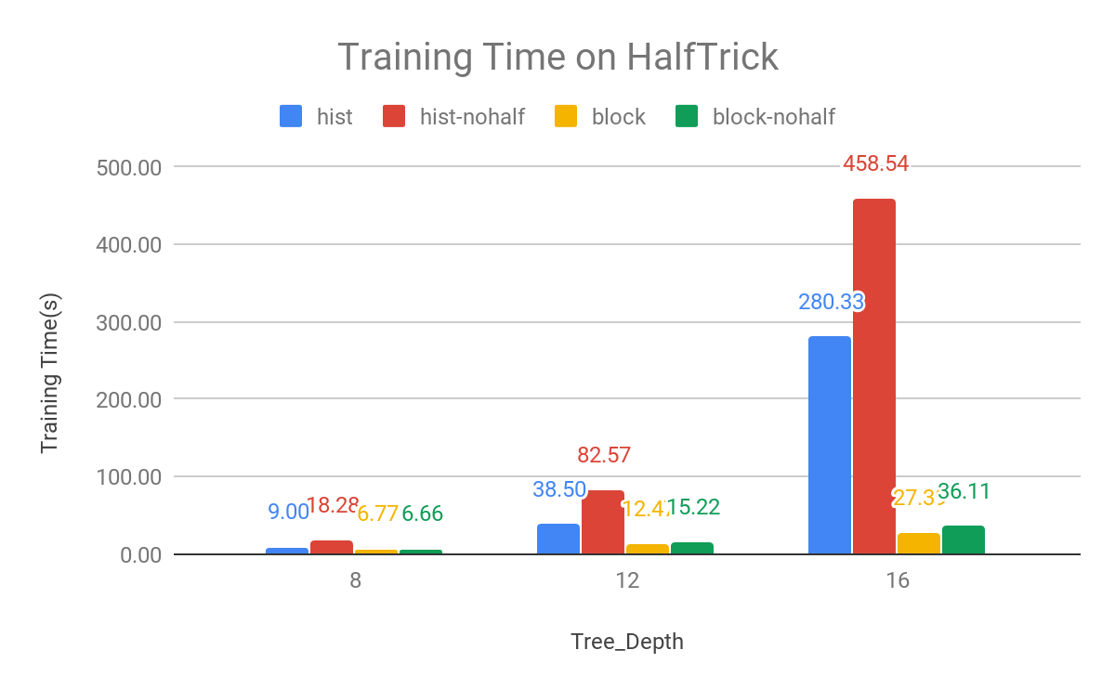
Is HalfTrick Useful?
halftrick: GHSum_right = GHSum_parent - GHSum_left
implementation: in block parallelism, no rowset maintained, need to check node left/right for each row of data instances
pros: reduce write operations to half
cons: at least ¼ more memory needed to reserve parents nodes

Slide 25
Future Plan
Distributed Version Implementation
Model Parallelism Kernel(DAAL Kernel)
if parallelism designed on BLOCKS, then it is ready to model rotation
for example, the code accept <feature>, or <nodeid> sets to train
Model Rotation(Harp Collective Communication)
c++ rotation code is ready, @chathuara is working on implementing using model rotation in GBT.

Slide 26
Future Plan
Paper
Problem: efficient parallel design for GBT
existing tools did not give good performance
related works did not give a clear answer
Basic Idea:
BLOCK-Based model parallelism
enable to discuss different trade-off between different configurations of BLOCK
find out optimal solution for different senarios (tree depth, dataset size, etc.)
Provide a high performance trainer
DAAL Kernel + Harp Model Rotation

Slide 27
Q&A

Slide 28
Recap

Slide 29
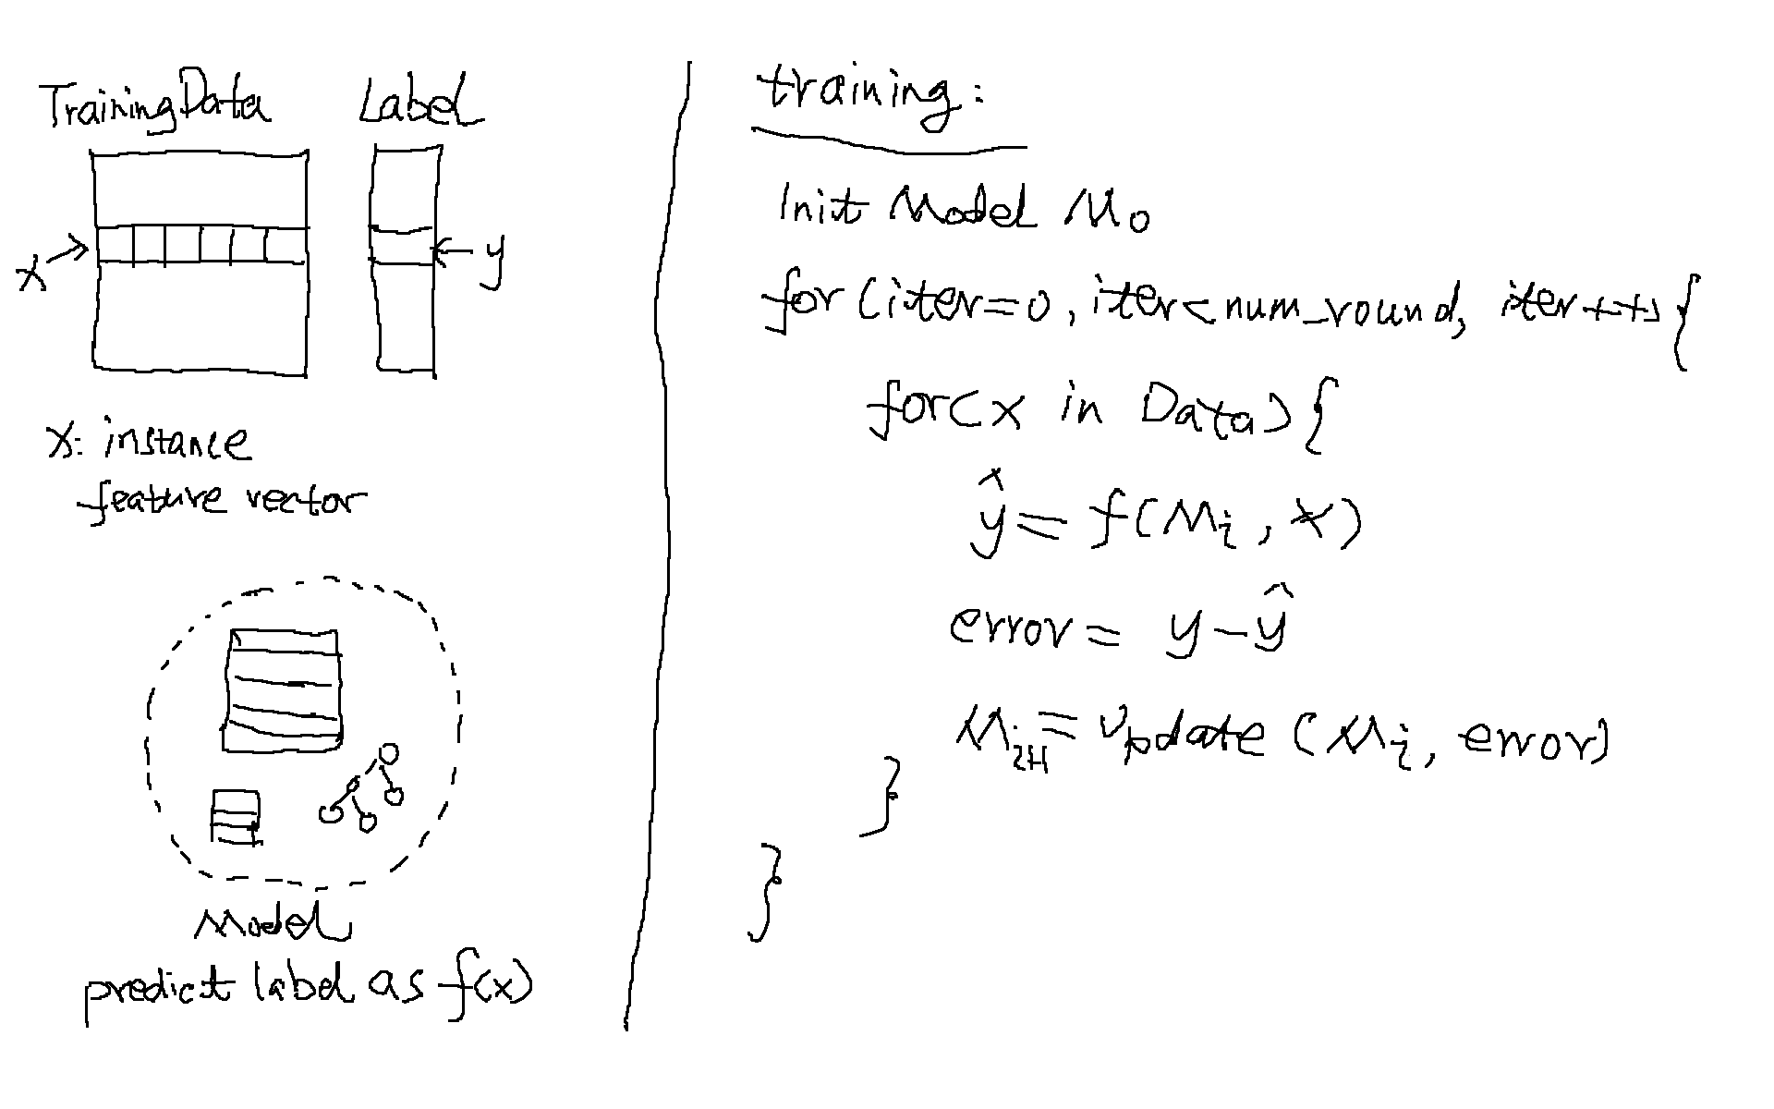
Basic Ideas Recap
Machine learning algorithm

Slide 30
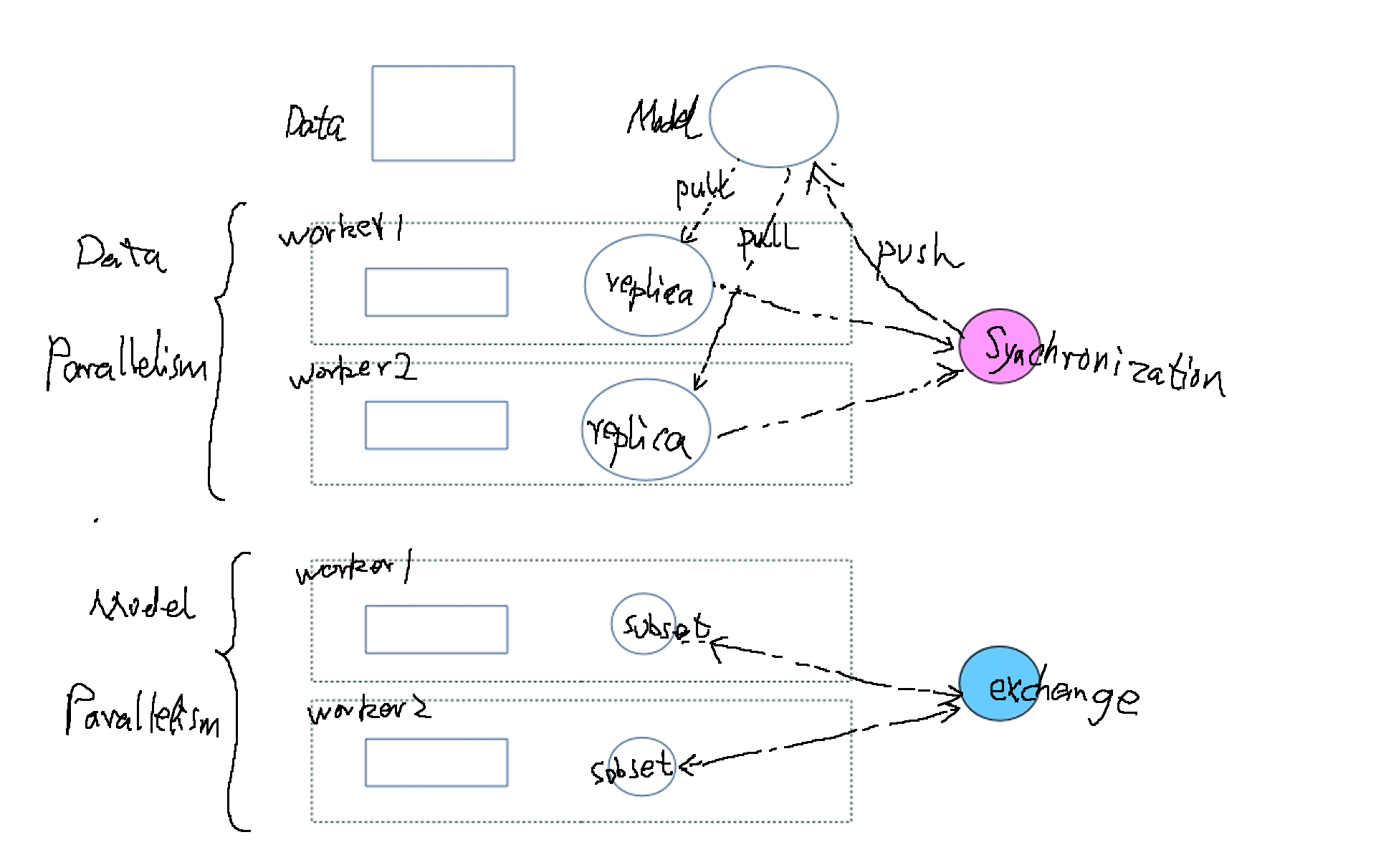
Basic Ideas Recap
Two approaches to parallelize the training algorithm

Slide 31
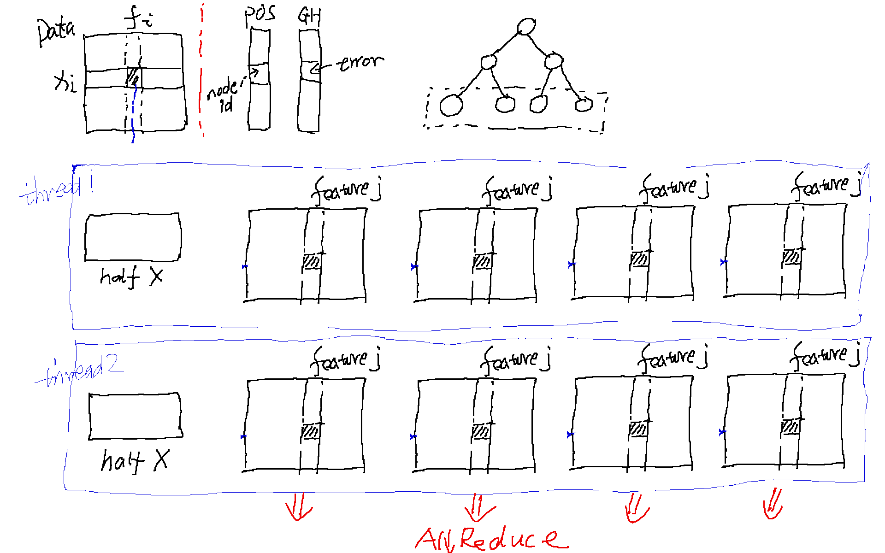
Solution Example: xgb-hist

Slide 32
Solution Example: xgb-hist
solution:
row-wised training data orgnization
data parallelism: data partition by rowid
maintain node rowset (aggregate the same nodeid togather in POS)
read Pos sequentially, random access to rows of training data
write thread-local GHSum and do all-reduce in the end
pros : read cache friendly
read cache friendly, read POS/GH and data only once
write to thread local memory, easy to introduce more parallelism
cons : write can be a problem
potential write cache miss for dataset with large number of features, write to a region with space of <feature_number × binid_size>
1k features, binid_size=256, region = 2MB, can not fit to L1
copies of the model occupy much more memory, model copies = 2^max_depth * threadNumber
potentially a problem in case of deep tree and large number of threads

Slide 33
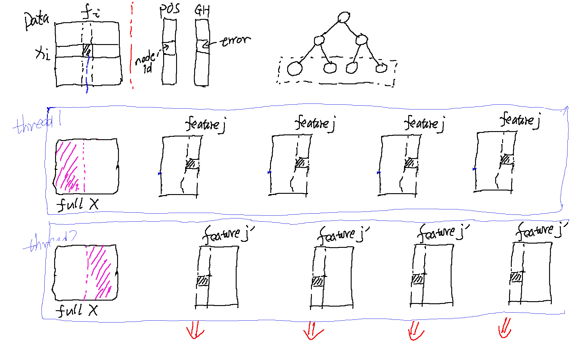
Solution Example: xgb-approx, daalgbt-2018

Slide 34
Solution Example: xgb-approx, daalgbt-2018
solution:
(feature)column-wised training data orgnization
model parallelism: feature level parallelism, (support nodeid level)
maintain node rowset (aggregate the same nodeid togather in POS)
read Pos sequentially, random access to training data
write GHSum without conflicts in multithreading
pros : write cache friendly
each thread write to different small regions, inside which <featureid, nodeid> are the same,
binid_size=256, 2K fit into L1
cons : read not cache friendly
read only one feature in one example at most, the others in cache line are wasted due to the random access pattern
read POS/GH reduntantly among threads

Slide 35
Basic Ideas - Compact Data Structure
Use binid instead of fvalue during the tree building
max_bins 256, 1 Byte compact for dense input
release the memory of the source input matrix

Slide 36
Basic Ideas- Vectorization
BuildHist is not computation intensive
indirect memory access
even scatter/gather vectorization seems to be infeasible here
hard to avoid conflicts in write
computation on GHSum can be vectorized
halftrick: GHSum_right = GHSum_parent - GHSum_left

Slide 37
Block-based Parallelism Implementation
training data:
block := <row_blk_size, bin_blk_size, feature_blk_size>, 0 for all
scheduler:
blocks with smaller row_block_id first, in order to reuse POS/GH
for row-blocks, currently use spinlock to avoid conflicts (todo: try thead-local model copy)
implementation, currently use omp dynamic scheduler (todo: priority contorl)
Block-based parallelism
block=<0, 256,1> equals to feature-wised solution xgb-approx (except no rowset matained and no random read access)
block=<0, 256,0> equals to row-wised solution xgb-hist, but limited threads number
block=<0, 256,16> keep balance for read/write
block=<0,16,0> similiar to xgb-hist, but support 16 threads write to model without conflicts
...

Slide 38
Future Plan
Sampling Algorithm
add approximation to get the statistics of GHSum
similiar to Histogram, using partial examples is possible to get enough accurate GHSum, the sampling algorithm should be important
Distributed version
BlockVersion + Sampling + Harp CollectiveCommunication(rotation)

Slide 39
Cost Model
Read
read continuously and reuse if possible
Write
make write operations in constrained small region if possible

Slide 40
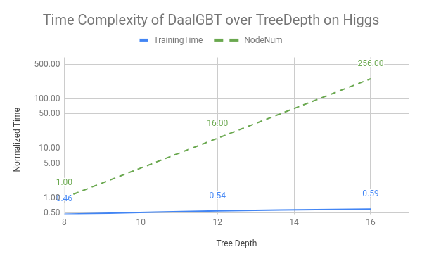
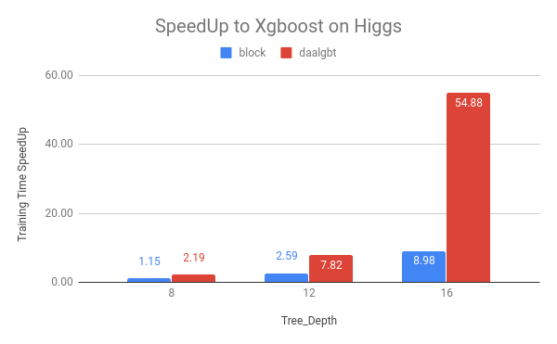
DAAL2019-Update1.1
Excellent performance!
Good performance over tree depth

Slide 41
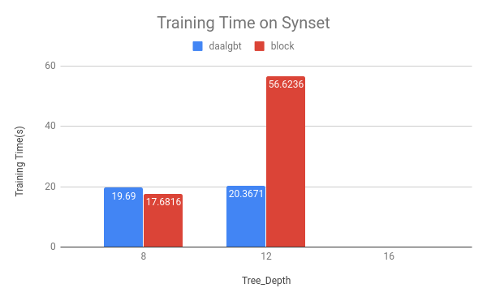
DAAL2019-Update1.1
on synset, 1024 features

Slide 42
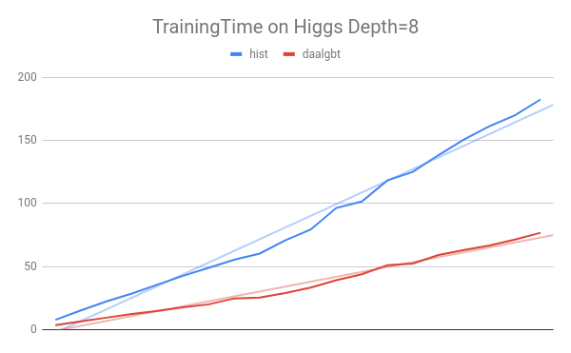
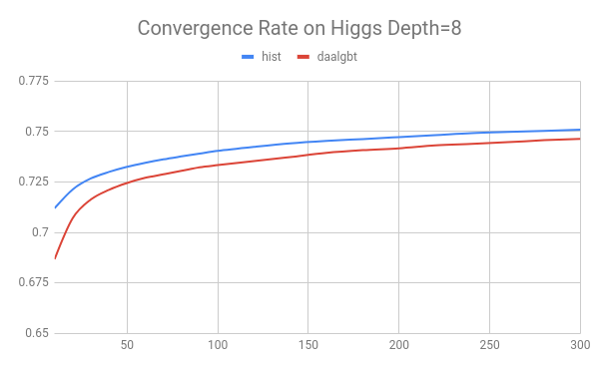
DAAL2019-Update1.1
issues
relatively lower convergence rate
different settings?

